Slide 1

OncoDiversity.jl
worked example used to tests for Juila package
Meghan C. Ferrall-Fairbanks, PhD

Slide 2
Diversity Metrics
ZOO 1
ZOO 2
Both zoos have 17 animals
species distribution
Zoo 1 | 3 | 2 | 2 | 3 | 0 | 3 | 4
Zoo 2 | 2 | 1 | 0 | 0 | 3 | 3 | 8

Slide 3
Diversity Metrics
ZOO 1
ZOO 2
Both zoos have 17 animals
species
frequency distribution
Zoo 1 | 0.18 | 0.12 | 0.12 | 0.18 | 0 | 0.18 | 0.22
Zoo 2 | 0.12 | 0.06 | 0 | 0 | 0.18 | 0.18 | 0.46

Slide 4
Diversity Metrics
species
frequency distribution
Zoo 1 | 0.18 | 0.12 | 0.12 | 0.18 | 0 | 0.18 | 0.22
Zoo 2 | 0.12 | 0.06 | 0 | 0 | 0.18 | 0.18 | 0.46
p_{i}
DIVERSITY METRIC COMPARISON
ZOO 1
ZOO 2
Which is larger?
Number species 6 5
Number of individuals 17 17
Shannon index (ln ¹D) 1.768 1.3978
Simpson index (1/²D) 0.1744 0.2944
^{0.01}D (low q) 5.999 4.989
¹⁰⁰D (high q) 4.616 2.191
Δ^{q}D 1.383 2.798
Notes:
-0.3572

Slide 5
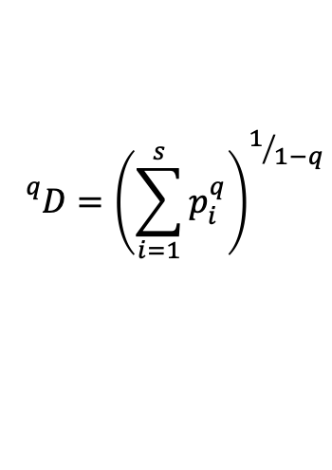
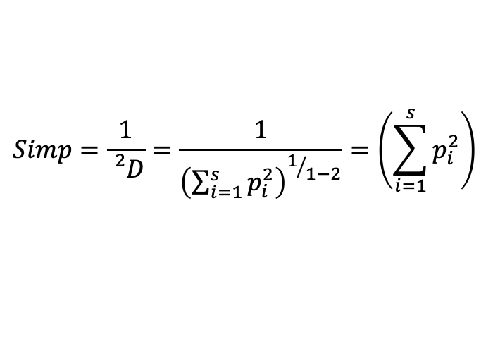
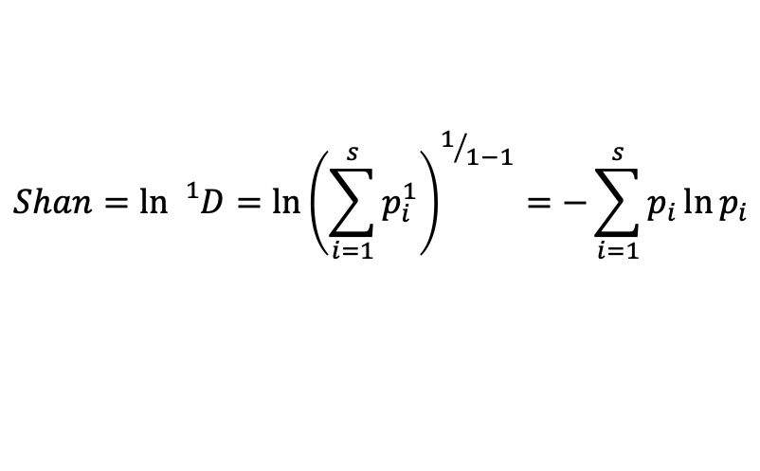
Diversity Metrics
General Diversity Index
$${}_{}^{q}D={\left(\sum_{i=1}^{s}{p_{i}^{q}}\right)}^{1/{1−q}}$$
If no evenness
(all p_{i}s=0 except 1)
If even
(all p_{i}s=1/n)
$$Shan=\ln{{}_{}^{1}D}=\ln{{\left(\sum_{i=1}^{s}{p_{i}^{1}}\right)}^{1/{1−1}}}=−\sum_{i=1}^{s}{p_{i}\ln{p_{i}}}$$
Shan=0
Shan=ln(n)
$$Simp=\frac{1}{{}_{}^{2}D}=\frac{1}{{\left(\sum_{i=1}^{s}{p_{i}^{2}}\right)}^{1/{1−2}}}=\left(\sum_{i=1}^{s}{p_{i}^{2}}\right)$$
Simp=1
Simp=1/n
n: number of types
p_{i}: frequency of type i

Slide 6
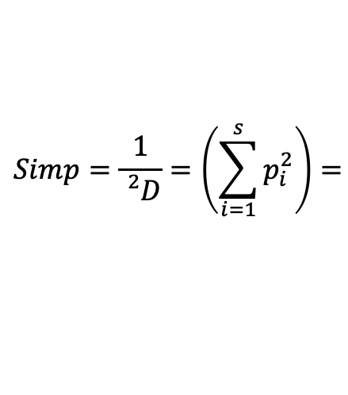
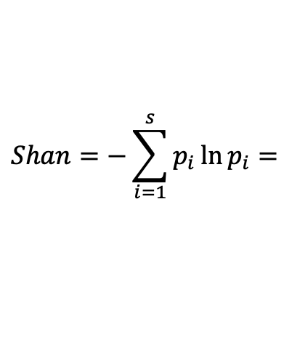
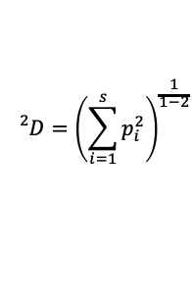
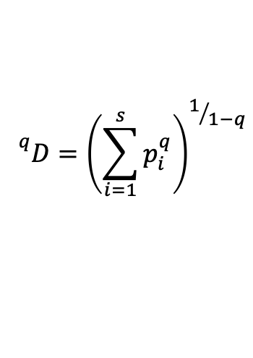
Diversity Metrics
$${}_{}^{q}D={\left(\sum_{i=1}^{s}{p_{i}^{q}}\right)}^{1/{1−q}}$$
species
frequency distribution
Zoo 1 | 0.18 | 0.12 | 0.12 | 0.18 | 0 | 0.18 | 0.22
Zoo 2 | 0.12 | 0.06 | 0 | 0 | 0.18 | 0.18 | 0.46
p_{i}
ZOO 1
p_{i} | 0.18 | 0.12 | 0.12 | 0.18 | 0 | 0.18 | 0.22
p_{i}² | 0.0324 | 0.0144 | 0.0144 | 0.0324 | 0 | 0.0324 | 0.0484
ln p_{i} | -1.7148 | -2.1203 | -2.1203 | -1.7148 | - | -1.7148 | -1.5141
p_{i} ln p_{i} | -0.3087 | -0.2544 | -0.2544 | -0.3087 | 0 | -0.3087 | -0.3331
$$Shan=−\sum_{i=1}^{s}{p_{i}\ln{p_{i}}}=$$
-(-0.3087+-0.2544+-0.2544+-0.3087+-0.3087+-0.3331)
= 1.768
$$Simp=\frac{1}{{}_{}^{2}D}=\left(\sum_{i=1}^{s}{p_{i}^{2}}\right)=$$
$${}_{}^{2}D={\left(\sum_{i=1}^{s}{p_{i}^{2}}\right)}^{\frac{1}{1−2}}$$
(0.0324+0.0144+0.0144+0.0324+0.0324+0.0484)
= 0.1744

Slide 7
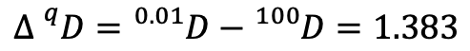
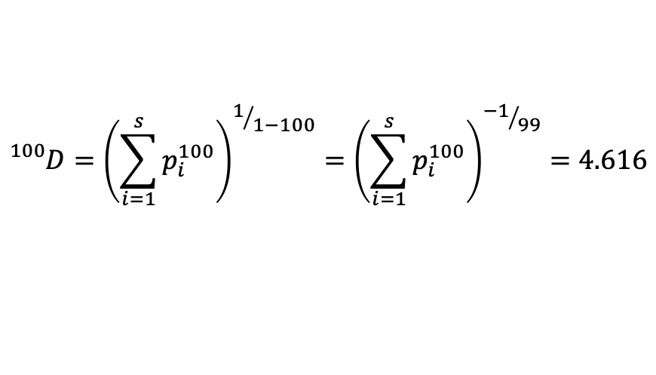
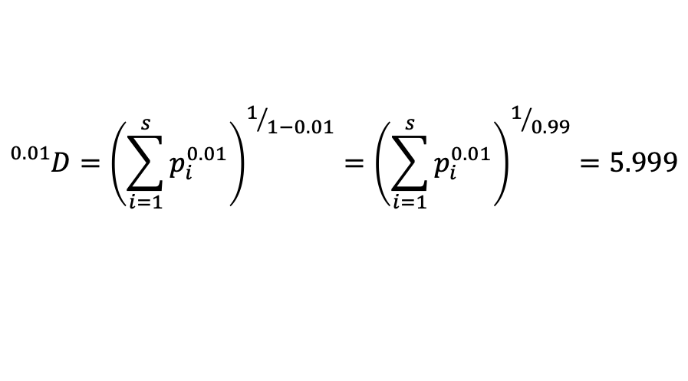
Diversity Metrics
$${}_{}^{q}D={\left(\sum_{i=1}^{s}{p_{i}^{q}}\right)}^{1/{1−q}}$$
species
frequency distribution
Zoo 1 | 0.18 | 0.12 | 0.12 | 0.18 | 0 | 0.18 | 0.22
Zoo 2 | 0.12 | 0.06 | 0 | 0 | 0.18 | 0.18 | 0.46
p_{i}
ZOO 1
$${}_{}^{0.01}D={\left(\sum_{i=1}^{s}{p_{i}^{0.01}}\right)}^{1/{1−0.01}}={\left(\sum_{i=1}^{s}{p_{i}^{0.01}}\right)}^{1/{0.99}}=5.999$$
$${}_{}^{100}D={\left(\sum_{i=1}^{s}{p_{i}^{100}}\right)}^{1/{1−100}}={\left(\sum_{i=1}^{s}{p_{i}^{100}}\right)}^{{−1}/{99}}=4.616$$
$$Δ{}_{}^{q}D={}_{}^{0.01}D−{}_{}^{100}D=1.383$$
$${}_{}^{2}D={\left(\sum_{i=1}^{s}{p_{i}^{2}}\right)}^{\frac{1}{1−2}}$$

Slide 8
Diversity Metrics
$${}_{}^{q}D={\left(\sum_{i=1}^{s}{p_{i}^{q}}\right)}^{1/{1−q}}$$
species
frequency distribution
Zoo 1 | 0.18 | 0.12 | 0.12 | 0.18 | 0 | 0.18 | 0.22
Zoo 2 | 0.12 | 0.06 | 0 | 0 | 0.18 | 0.18 | 0.46
p_{i}
ZOO 2
p_{i} | 0.12 | 0.06 | 0 | 0 | 0.18 | 0.18 | 0.46
p_{i}² | 0.0144 | 0.0036 | 0 | 0 | 0.0324 | 0.0324 | 0.2116
ln p_{i} | -2.1203 | -2.8134 | - | - | -1.7148 | -1.7148 | -0.7765
p_{i} ln p_{i} | -0.2544 | -0.1688 | 0 | 0 | -0.3087 | -0.3087 | -0.3572
$$Shan=−\sum_{i=1}^{s}{p_{i}\ln{p_{i}}}=$$
-(-0.2544+-0.1688+-0.3087+-0.3087+-0.3572)
= 1.3978
$$Simp=\frac{1}{{}_{}^{2}D}=\left(\sum_{i=1}^{s}{p_{i}^{2}}\right)=$$
$${}_{}^{2}D={\left(\sum_{i=1}^{s}{p_{i}^{2}}\right)}^{\frac{1}{1−2}}$$
(0.0144+0.0036+0.0324+0.0324+0.2116)
= 0.2944
Notes:
-0.3572

Slide 9
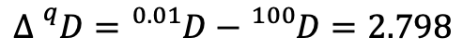
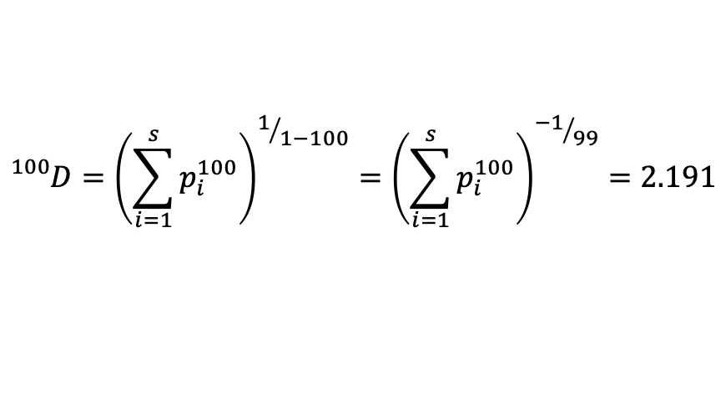
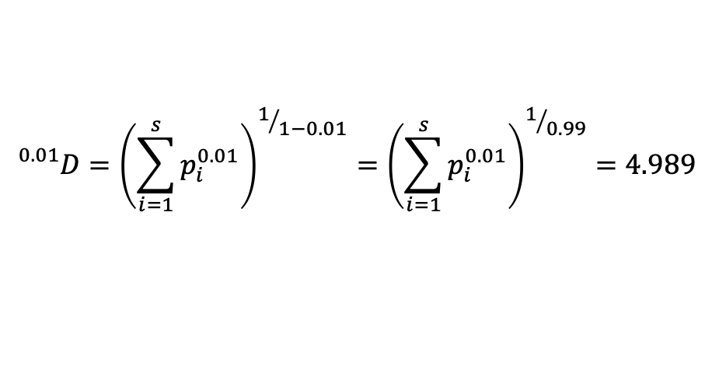
Diversity Metrics
$${}_{}^{q}D={\left(\sum_{i=1}^{s}{p_{i}^{q}}\right)}^{1/{1−q}}$$
species
frequency distribution
Zoo 1 | 0.18 | 0.12 | 0.12 | 0.18 | 0 | 0.18 | 0.22
Zoo 2 | 0.12 | 0.06 | 0 | 0 | 0.18 | 0.18 | 0.46
p_{i}
ZOO 2
$${}_{}^{0.01}D={\left(\sum_{i=1}^{s}{p_{i}^{0.01}}\right)}^{1/{1−0.01}}={\left(\sum_{i=1}^{s}{p_{i}^{0.01}}\right)}^{1/{0.99}}=4.989$$
$${}_{}^{100}D={\left(\sum_{i=1}^{s}{p_{i}^{100}}\right)}^{1/{1−100}}={\left(\sum_{i=1}^{s}{p_{i}^{100}}\right)}^{{−1}/{99}}=2.191$$
$$Δ{}_{}^{q}D={}_{}^{0.01}D−{}_{}^{100}D=2.798$$
$${}_{}^{2}D={\left(\sum_{i=1}^{s}{p_{i}^{2}}\right)}^{\frac{1}{1−2}}$$

Slide 10
Zoo 3
ZOO 3
Zoo 3 has 17 animals
(like the other 2)
species distribution
Zoo 3 | 1 | 1 | 0 | 0 | 0 | 0 | 15
 | 0.059 | 0.059 | 0 | 0 | 0 | 0 | 0.882

Slide 11
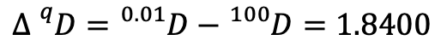
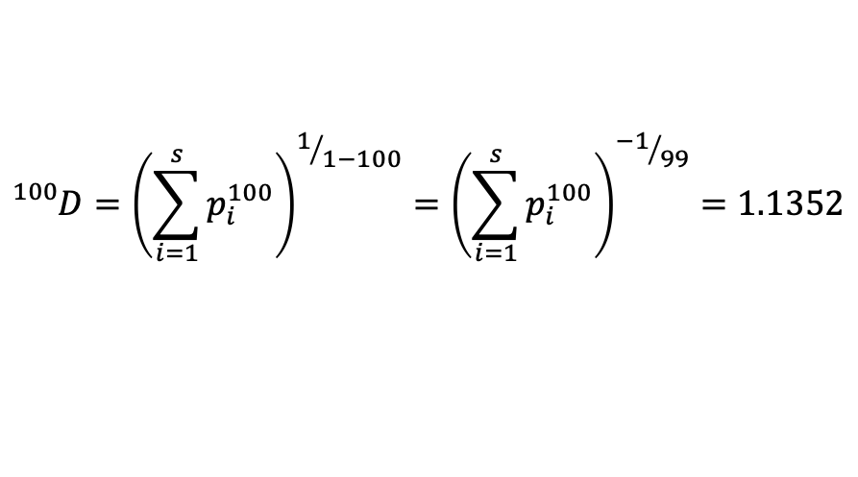
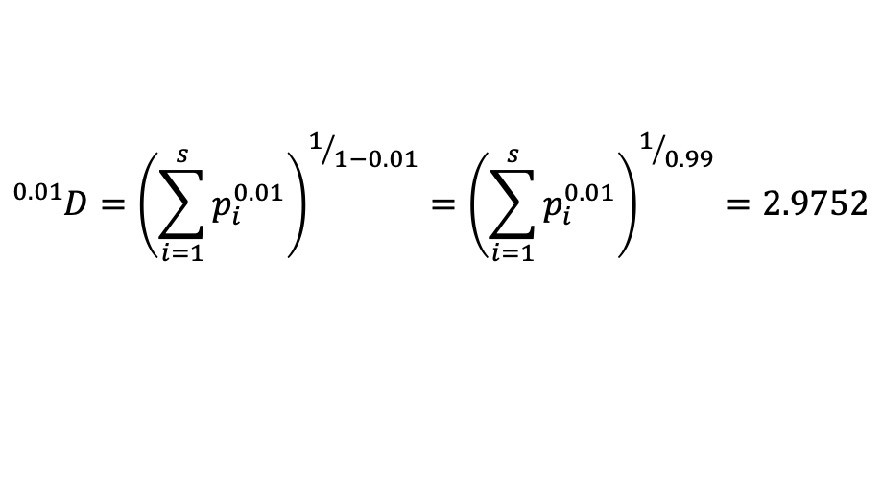
Zoo 3
$${}_{}^{q}D={\left(\sum_{i=1}^{s}{p_{i}^{q}}\right)}^{1/{1−q}}$$
count
frequency distribution
Zoo 3 | 1 | 1 | 0 | 0 | 0 | 0 | 15
Zoo 3 | 0.059 | 0.059 | 0 | 0 | 0 | 0 | 0.882
p_{i}
ZOO 3
$${}_{}^{0.01}D={\left(\sum_{i=1}^{s}{p_{i}^{0.01}}\right)}^{1/{1−0.01}}={\left(\sum_{i=1}^{s}{p_{i}^{0.01}}\right)}^{1/{0.99}}=2.9752$$
$${}_{}^{100}D={\left(\sum_{i=1}^{s}{p_{i}^{100}}\right)}^{1/{1−100}}={\left(\sum_{i=1}^{s}{p_{i}^{100}}\right)}^{{−1}/{99}}=1.1352$$
$$Δ{}_{}^{q}D={}_{}^{0.01}D−{}_{}^{100}D=1.8400$$
$${}_{}^{2}D={\left(\sum_{i=1}^{s}{p_{i}^{2}}\right)}^{\frac{1}{1−2}}$$

Slide 12
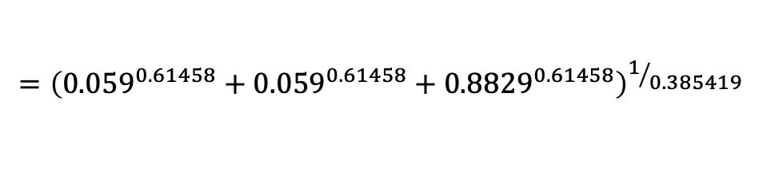
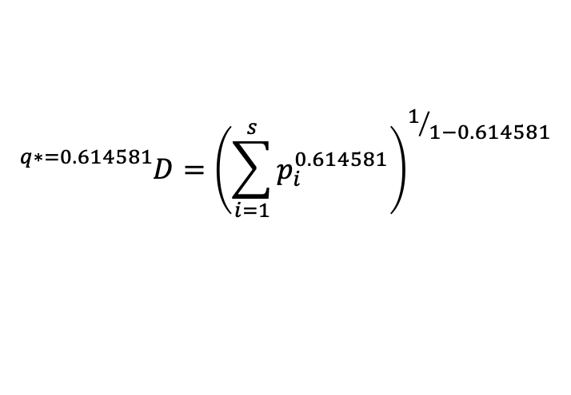
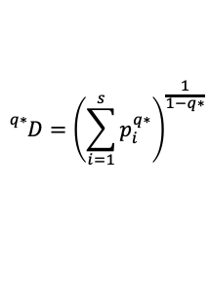
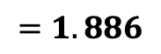
Zoo 3
$${}_{}^{q}D={\left(\sum_{i=1}^{s}{p_{i}^{q}}\right)}^{1/{1−q}}$$
count
frequency distribution
Zoo 3 | 1 | 1 | 0 | 0 | 0 | 0 | 15
Zoo 3 | 0.059 | 0.059 | 0 | 0 | 0 | 0 | 0.882
p_{i}
ZOO 3
q* = 0.614581 (q where inflection point occurs)
$${}_{}^{q∗}D={\left(\sum_{i=1}^{s}{p_{i}^{q∗}}\right)}^{\frac{1}{1−q∗}}$$
$${}_{}^{q∗=0.614581}D={\left(\sum_{i=1}^{s}{p_{i}^{0.614581}}\right)}^{1/{1−0.614581}}$$
q* = q where the inflection point occurs
$$={\left({0.059}^{0.61458}+{0.059}^{0.61458}+{0.8829}^{0.61458}\right)}^{1/{0.385419}}$$
$$={\left(0.175626+0.175626+0.92573\right)}^{2.59458}$$
$$=1.886$$

